Slide 1
Flight Delays
Final Machine Learning Project
Siqing Cao, Bianca Garcia, Dale George, and Peyton Harsh
2020

Slide 2
Which airline should I take this coming January 2021? Will my flight be delayed?

Slide 3
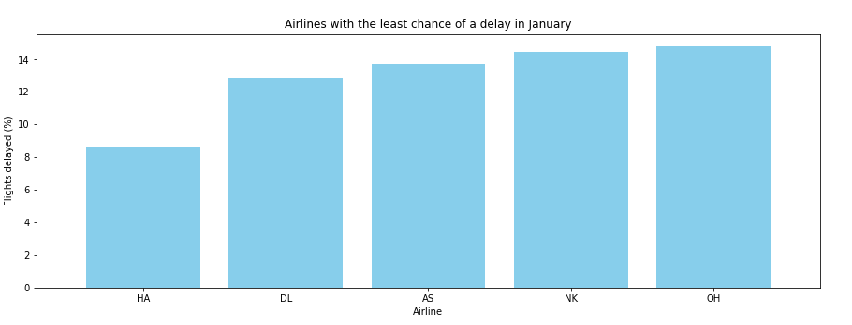
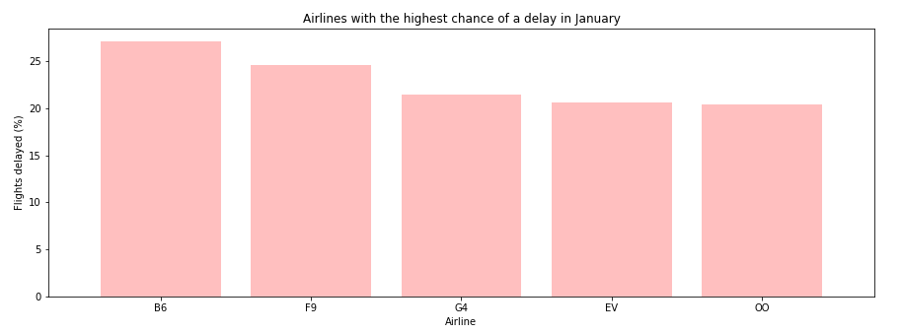
Airlines:
HA – Hawaiian
DL – Delta
AS – Alaska
NK – Spirit
OH – PSA
B6 – Jet Blue
F9 – Frontier
G4 – Allegiant
EV – Express Jet
OO – Skywest

Slide 4
Data
Kaggle – January 2019 US Flight Delays
Cleaned the Data
Created a Pipeline
One_Hot_Encoder
MinMaxScaler
Feature_Selection
Important for Predicting
Models Used
Gradient Boosting Classifier
Random Forest Classifier ( Two Models)
Dropped unnecessary data, columns, etc.
Balanced
Categorized non-numerical data

Slide 5
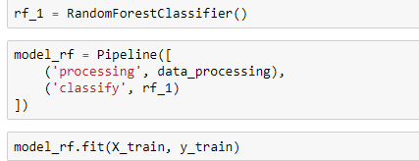
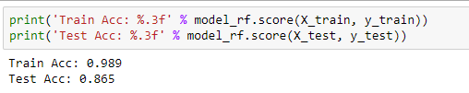
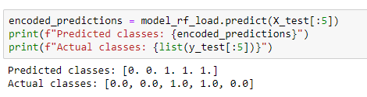
Random Forest Classifier ( 1st Model)
Building the Model
Results
Prediction

Slide 6
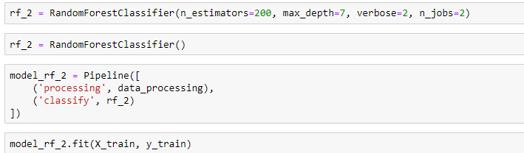

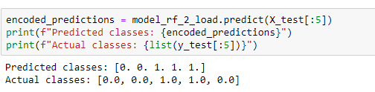
Random Forest Classifier ( 2nd Model)
Building the Model
Results
Prediction

Slide 7
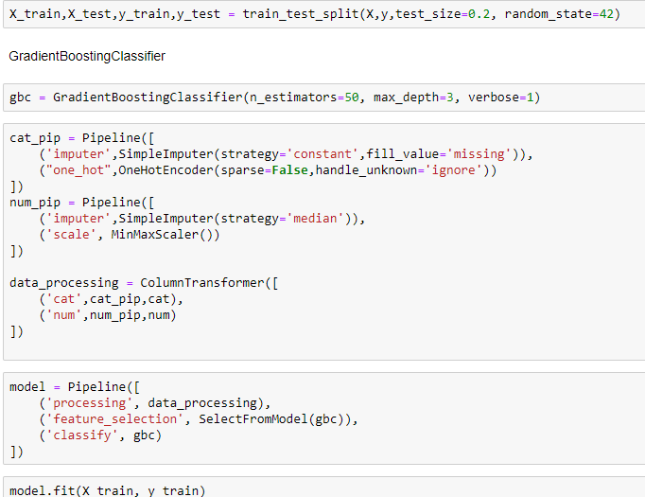

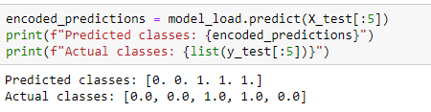
Gradient Boosting Classifier
Building the Model
Results
Prediction

Slide 8
Final thoughts
It is important to understand overfitting to have unbiased results
Using a Pipeline created a streamline approach in testing multiple models
Using the parameter ‘n_estimators’, we adjusted the model to become less ‘dumb’
Helping the model with overfitting
The GBC Model yielded the best results to decide if a flight would be delayed

